Slide 1
Recurrent Neural Network (RNN) Language Models
CS 162: Natural Language Processing
Nanyun (Violet) Peng
Course website: https://vnpeng.net/cs162_win24.html
syllabus,
announcements,
slides,
homeworks
1

Slide 2
Recurrent Neural Networks (RNNs)
Main idea: make use of sequential information
How RNN is different from feedforward neural network?
Feedforward neural networks assume all inputs are independent of each other
In many cases (especially for language), it is not true.
What does RNNs do?
Perform the same task at every step of a sequence (that’s what recurrent stands for)
Inputs to the next step depend on the previous computations
Another way of interpretation – RNNs have a “memory”
To store previous computations

Slide 3
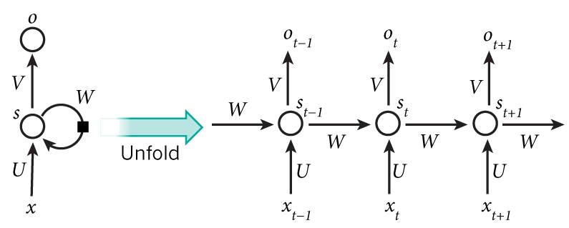
Recurrent Neural Networks (RNNs)
Hidden state at time step t
Output state at time step t
Activation function
h
h_{t-1}
h_{t}
h_{t+1}
Input at time step $t−1$
Parameters (recurrently used)

Slide 4
Recurrent Neural Networks (RNNs)
Mathematically, the computation at each time step:
Linear combination of the current input and previous step’s “memory”
Activation function (add non-linearity)
Linear transformation to convert current “memory” to output vec.
Make predictions based on the output vec.

Slide 5
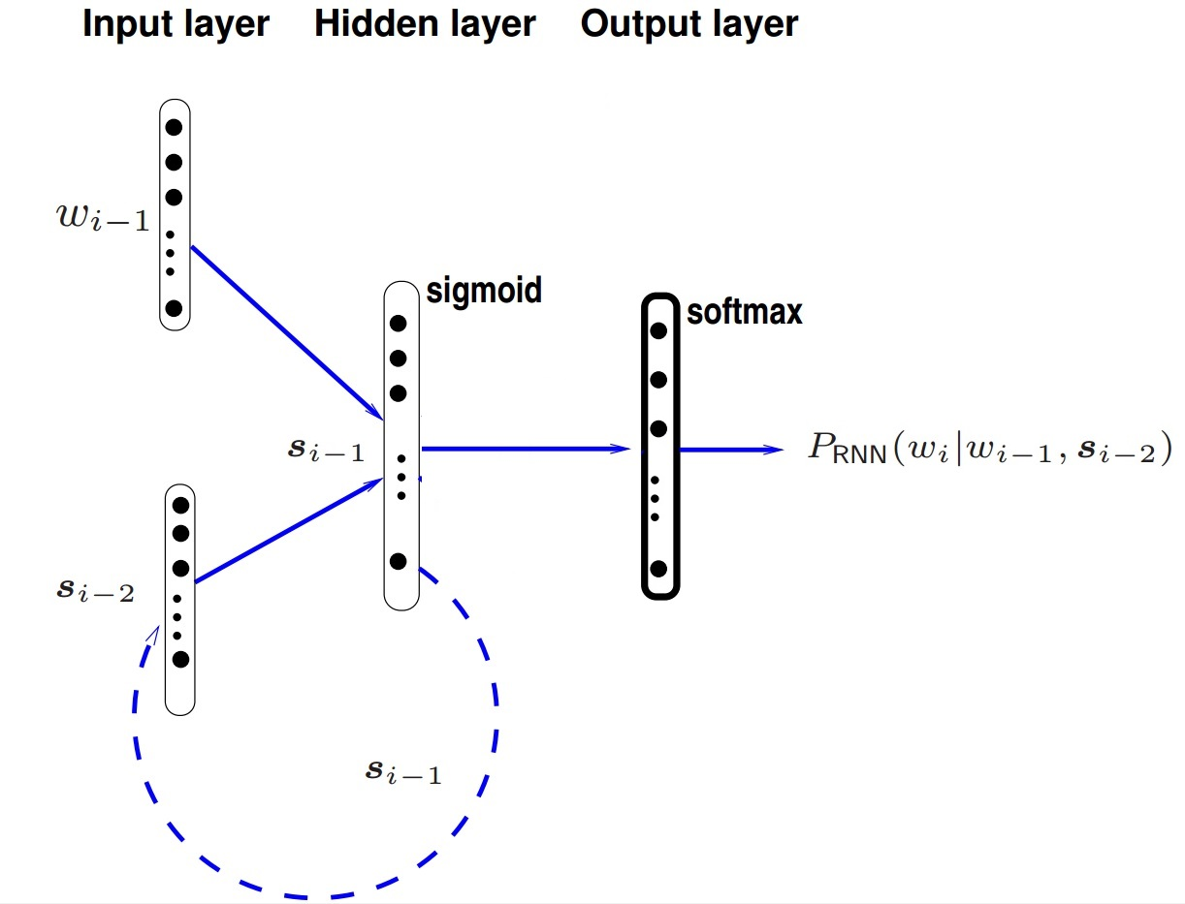
RNN Language Model
Model the probability of the next word at each step.
Notes:
In theory, can remember arbitrary length history;
In practice, will decide based on the input data.

Slide 6
RNN Language Model
P_{RNN}(x_{t}|x_{t-1}, s_{t-2})
P_{RNN}(x_{t+1}|x_{t}, s_{t-1})
P_{RNN}(x_{t+1}|x_{t+1}, s_{t})
Handles infinite context in theory

Slide 7
Long-Term Dependencies
Is RNN capable of capturing long-term dependencies?
What does it mean by “long-term”? Consider an example
Kevin's eye was caught by one number that was highlighted in the last report; this number represented the new algorithm's ability to create lengthy and coherent text on its own. This is unprecedented. The text contained more than 500 words, but the algorithm had generated many more than that – several thousands in fact. Kevin opened up two other files that contained several thousand words of AI generated text each. ...[52 words]...
Kevin rubbed his hands together in ___

Slide 8
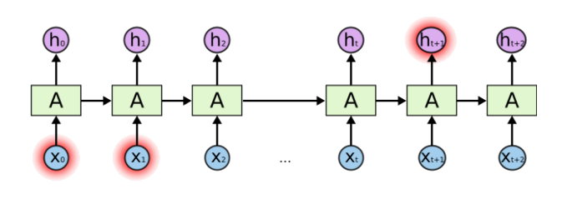
Problem of Long-Term Dependencies
What if we want to predict the next word in a long sentence?
Do we know which past information is helpful to predict the next word?
In theory, RNNs are capable of handling long-term dependencies.
But in practice, they are not! Reading: vanishing gradient problem.
Notes:
Vanishing gradient

Slide 9
Long Short Term Memory (LSTM)
A special type of recurrent neural networks.
Explicitly designed to capture the long-term dependency.
It solves/mitigates the vanishing gradient problem of vanilla RNN.
So, what is the structural difference between RNN and LSTM?

Slide 10
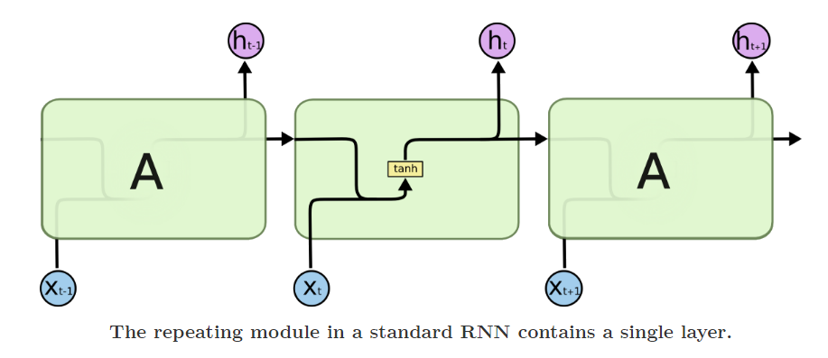
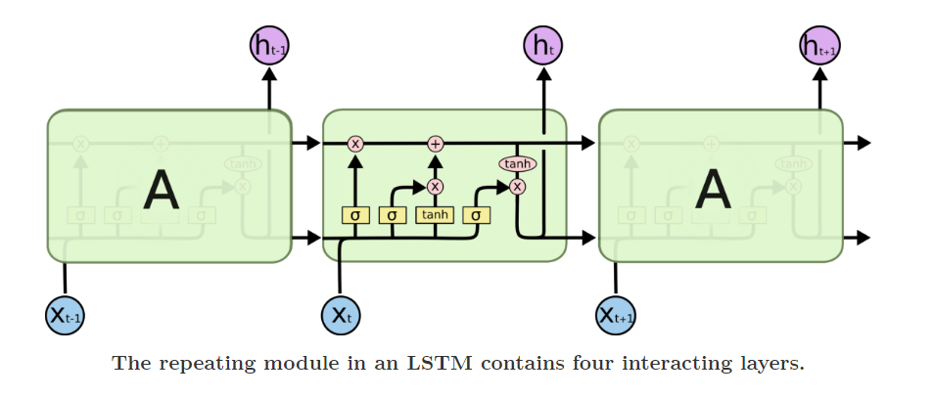
Difference between RNN and LSTM

Slide 11
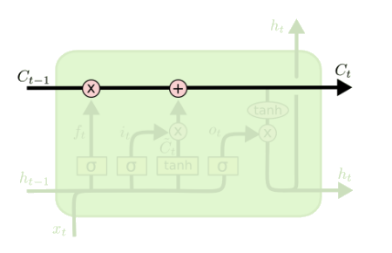
Core Idea Behind LSTM
Key to LSTMs is the memory cell state
LSTMs memory cells add and remove information as the sequence goes. Mathematically, it turns the cascading multiplications in vanilla RNNs into additions.
How? Through a structure called gate.
LSTM has three gates to control the memory in the cells

Slide 12
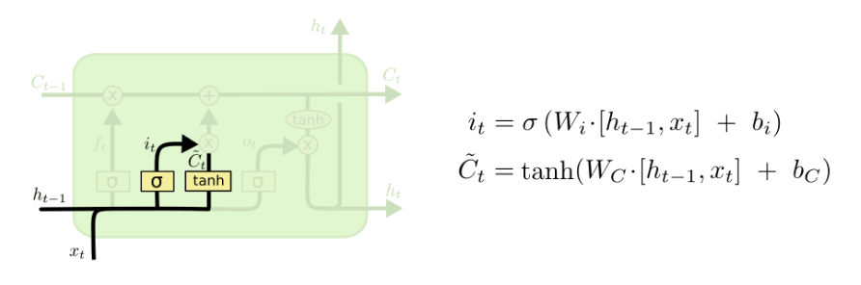

Step-by-Step LSTM Walk Through
The input gate decides what information will be taken from the current input and stored in the cell state
Two parts –
A sigmoid layer (input gate layer): decides what values we’ll update
A $tanh⁡$layer: creates a vector of new candidate values, $\tilde{C_{t}}$
Example: add the gender of the new subject to the cell state
Replace the old one we’re forgetting
Input gate layer
tanh layer

Slide 13
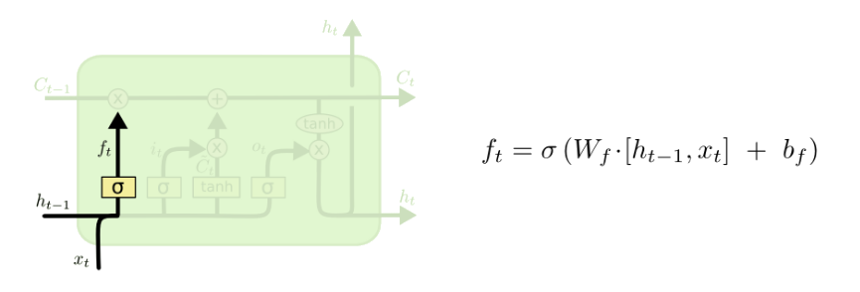

Step-by-Step LSTM Walk Through
The forget gate decides what information will be thrown away
A sigmoid layer decides what values we’ll forget
Looks at $h_{t−1}$ and $x_{t}$ and outputs a vector of numbers between 0 and 1
1 represents completely keep this, 0 represents completely get rid of this
Example: forget the gender of the old subject, when we see a new subject

Slide 14
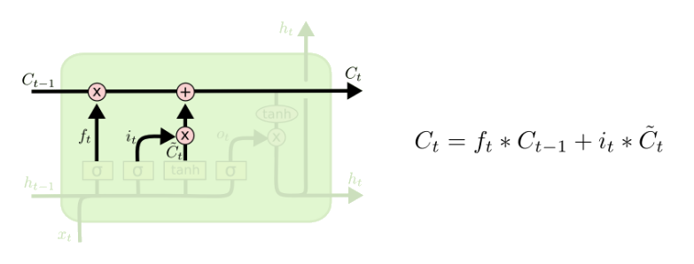

Step-by-Step LSTM Walk Through
Next step: update old state by $C_{t−1}$ into the new cell state $C_{t}$
Multiply old state by $f_{t}$
Forgetting the things we decided to forget earlier
Then we add $i_{t}∗\tilde{C_{t}}$
Adding in new information

Slide 15
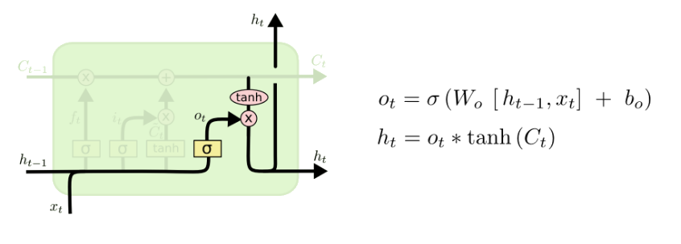
Step-by-Step LSTM Walk Through
Final step: decide what we’re going to output
First, we compute an output gate
Which decides what parts of the cell state we’re going to output
Then, we put the cell state through tanh and multiply it by the output of the sigmoid gate

Slide 16
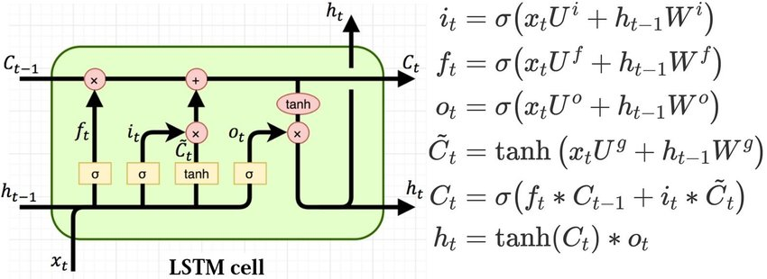
Putting Everything Together
Calculate the gates
Input information
Central memory
Output information

Slide 17
LSTMs Summary
LSTMs is an (advanced) variation of RNNs.
It captures long-term dependencies of the inputs.
Shown to be efficient in many NLP tasks.
A standard component to encode text inputs during 2014 - 2018.

Slide 18
Learning neural language models
Maximize the log-likelihood (minimize negative log-likelihood) of observed data, w.r.t. parameters θ of the neural language model
Parameters θ (in an RNN language model):
Word embedding matrix R
RNN weights: W, U, b, V, c
LSTM weights: W^{i}, W^{f}, Wº, W^{g}, U^{i}, U^{f}, Uº, U^{g} (optional, b^{i}, b^{f}, bº, b^{g})
Gradient descent with learning rate η:
auto-gradient

Slide 19
Next: Recent advances language models
The transformer architecture (dominate 2018 - now)
Pre-trained language models

